Slide 1

Learning fault trees from data
Introduction to topic
Juan Luengo Gallego
Seminar formal system analysis

Slide 2
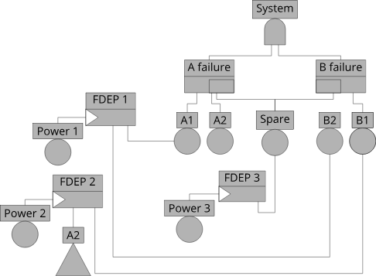
Fault trees
Key aspects:
- Hierarchical Structure
- Analysing Failure Scenarios
- Risk Assessment and Mitigation
[1]: S.Montani, L. Portinale, A. Bobbio, and D. Codetta-Raiteri: Radyban: A tool for reliability analysis of dynamic fault trees through conversion into dynamic Bayesian networks, 2008

Slide 3
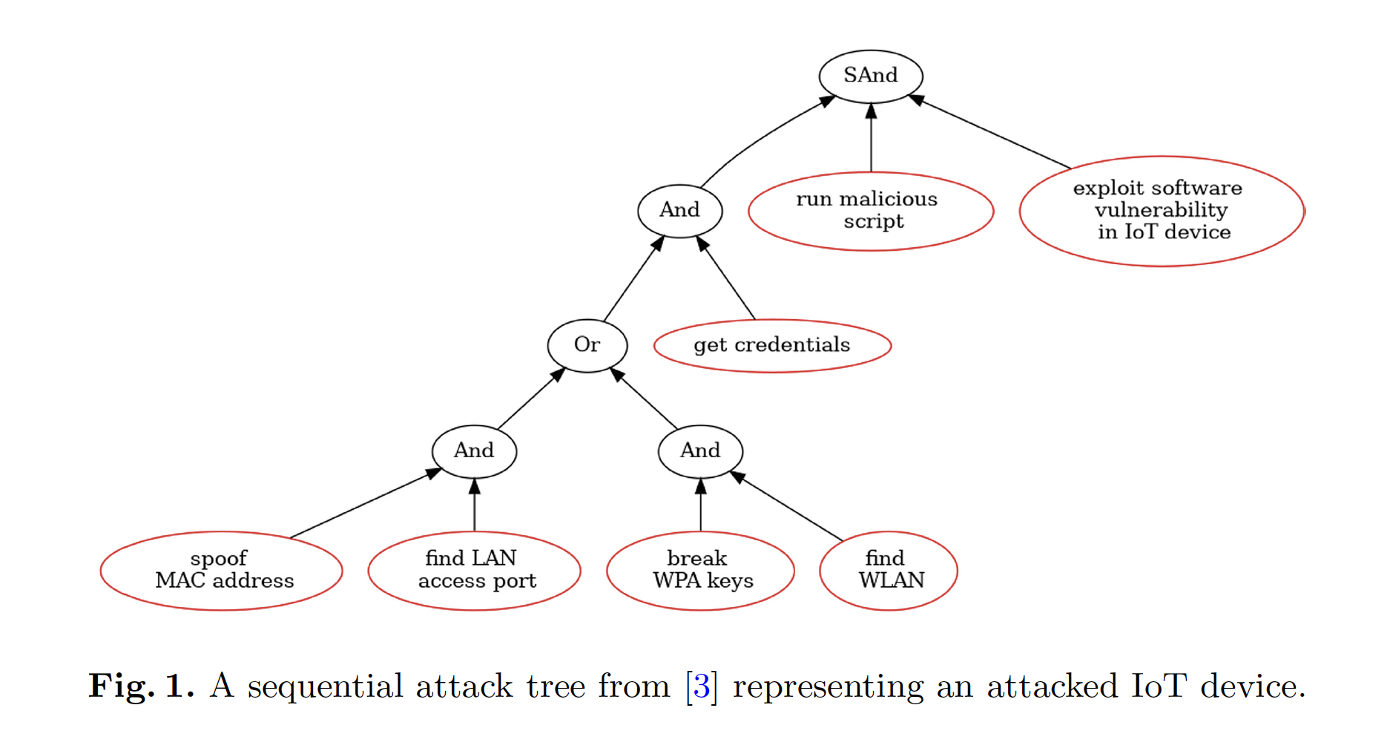
Attack trees
Main differences:
Deliberate malicious actions or attacks.
Cybersecurity and threat modeling.
Nodes represent potential attack steps or goals
[2] Dorfhuber et al. "Learning Attack Trees by Genetic Algorithms". ICTAC, 2023

Slide 4
Modelling attack trees
Requires human interaction to set them up (time, expertise, and resources).
From the ones that do create automatically:
Can only use past attacks as data.
Difficult to scale.
Need lot of data.

Slide 5
Paper - Learning Attack Trees by Genetic Algorithms
Create attack trees from smaller sets of data using and learning from sets of traces labeled as successful or unsuccessful attacks.
Compared to other approaches they obtained some observations:
Small models can be learned with 100% accuracy if all existing traces are given as input.
The algorithm is robust to overfitting due to sampling.
Dorfhuber et al. "Learning Attack Trees by Genetic Algorithms". ICTAC, 2023

Slide 6
Paper - Learning Attack Trees by Genetic Algorithms
The algorithm approach performs comparable to logistic regression with a mean difference of only 0.04 (standard deviation 0.01) but, in contrast, results in a graphical, interpretable model.
Only about 4% of all traces in the dataset need to be successful attacks to learn fit functions with a mean sensitivity of up to 95%, or specificity of up to 99%.

Slide 7

Questions
Notes:
I will investigate how this method compares to existing methods for fault trees generation

